Slide 1


Overview of Key Models: GPT, BERT, T5, LlaMa, Falcon
Pawan Goyal
Department of Computer Science and Engineering
IIT Kharagpur
https://cse.iitkgp.ac.in/~pawang/

Slide 2
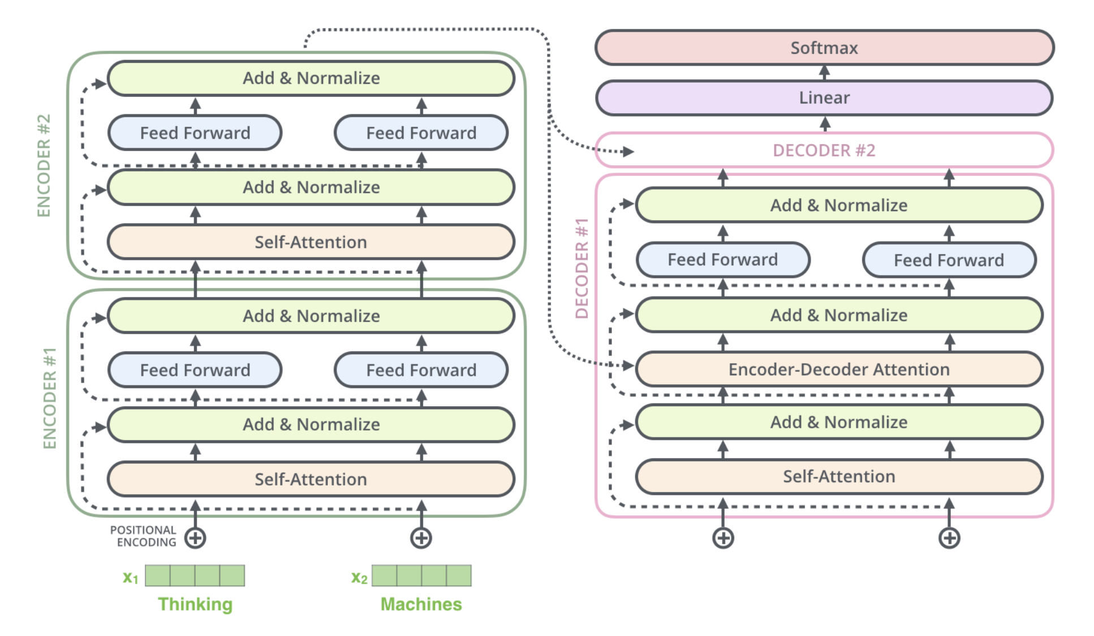
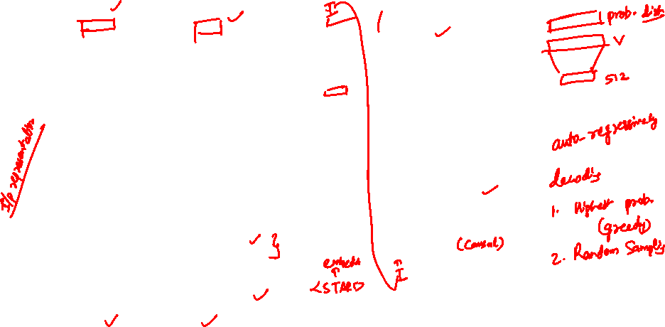
Transformer with 2 stacked encoders and decoders

Slide 3
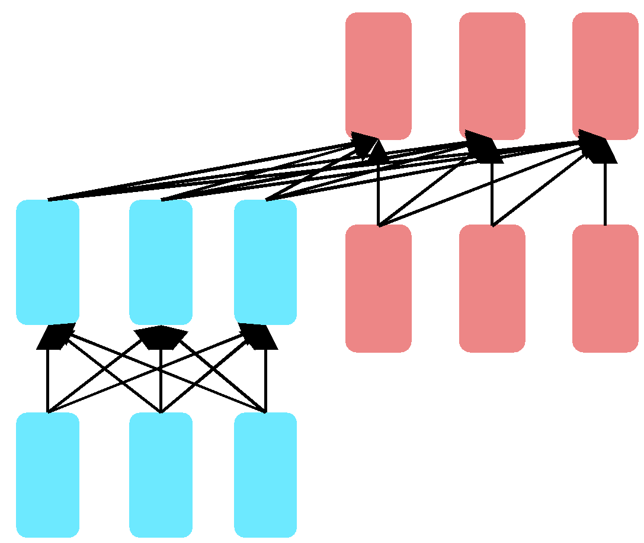
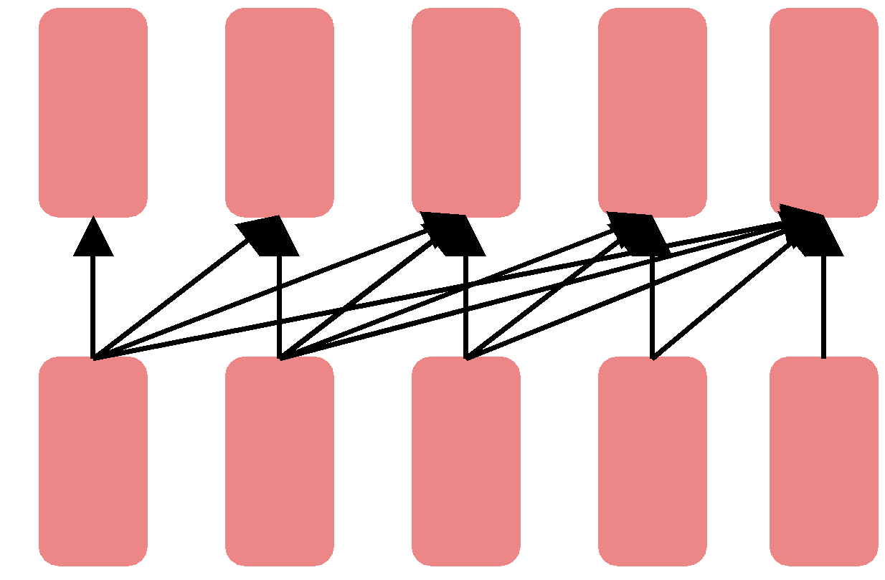
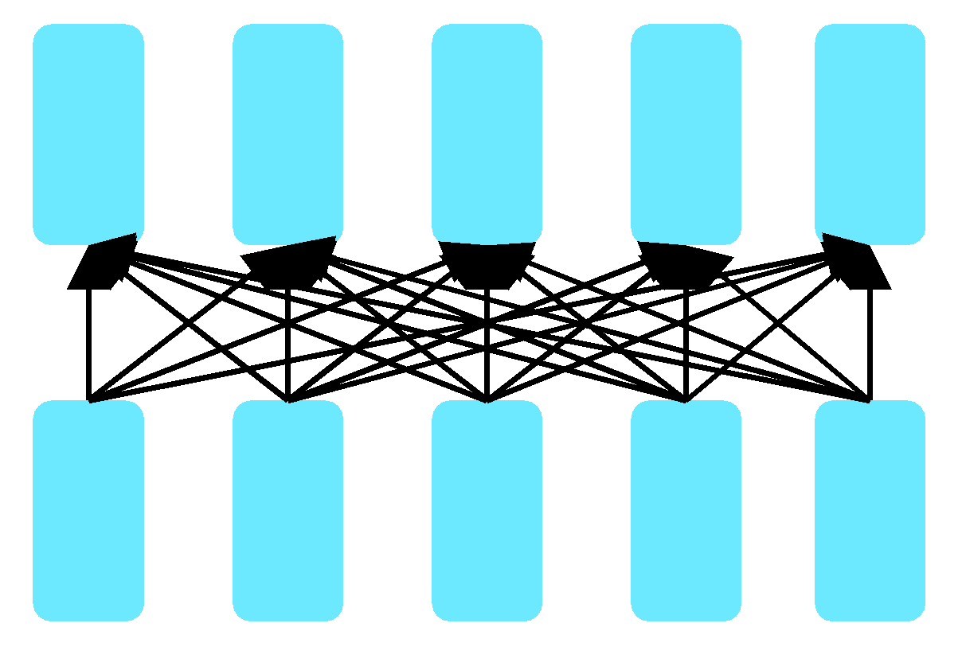

Three architectures for large language models
Decoders Encoders Encoder-decoders
GPT, Claude, BERT family Flan-T5
Llama, Falcon BART
These are all pretrained transformers

Slide 4

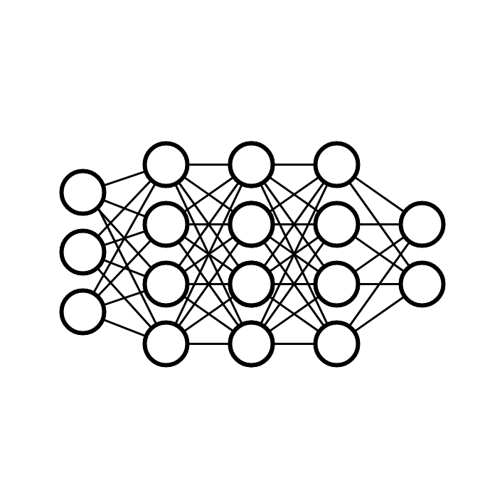
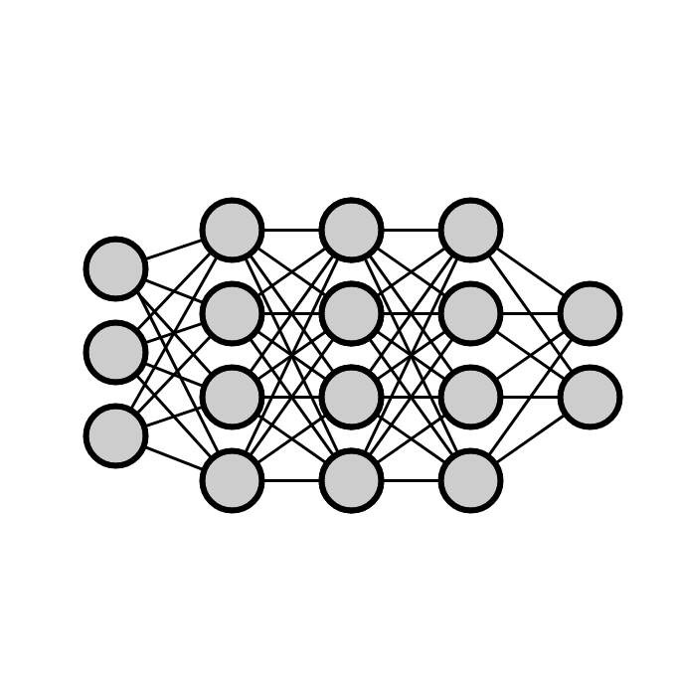


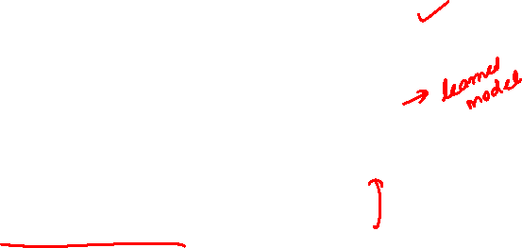
Standard Supervised Deep
Learning
(not) spam
+
+
text + labels
neural network starting from random weights
https://utah-cs6340-nlp.notion.site/Natural-Language-Processing-bd1a2ca290fc44f69556908ad8d25c70
Notes:
For example, all of us rely on automatic spam filtering that is most likely supported by a machine learning model.
Perhaps a deep neural network that is trained with a dataset of e-mails that are labeled as spam or not spam…
…which, once trained, predicts whether a new e-mail we got is spam.

Slide 5
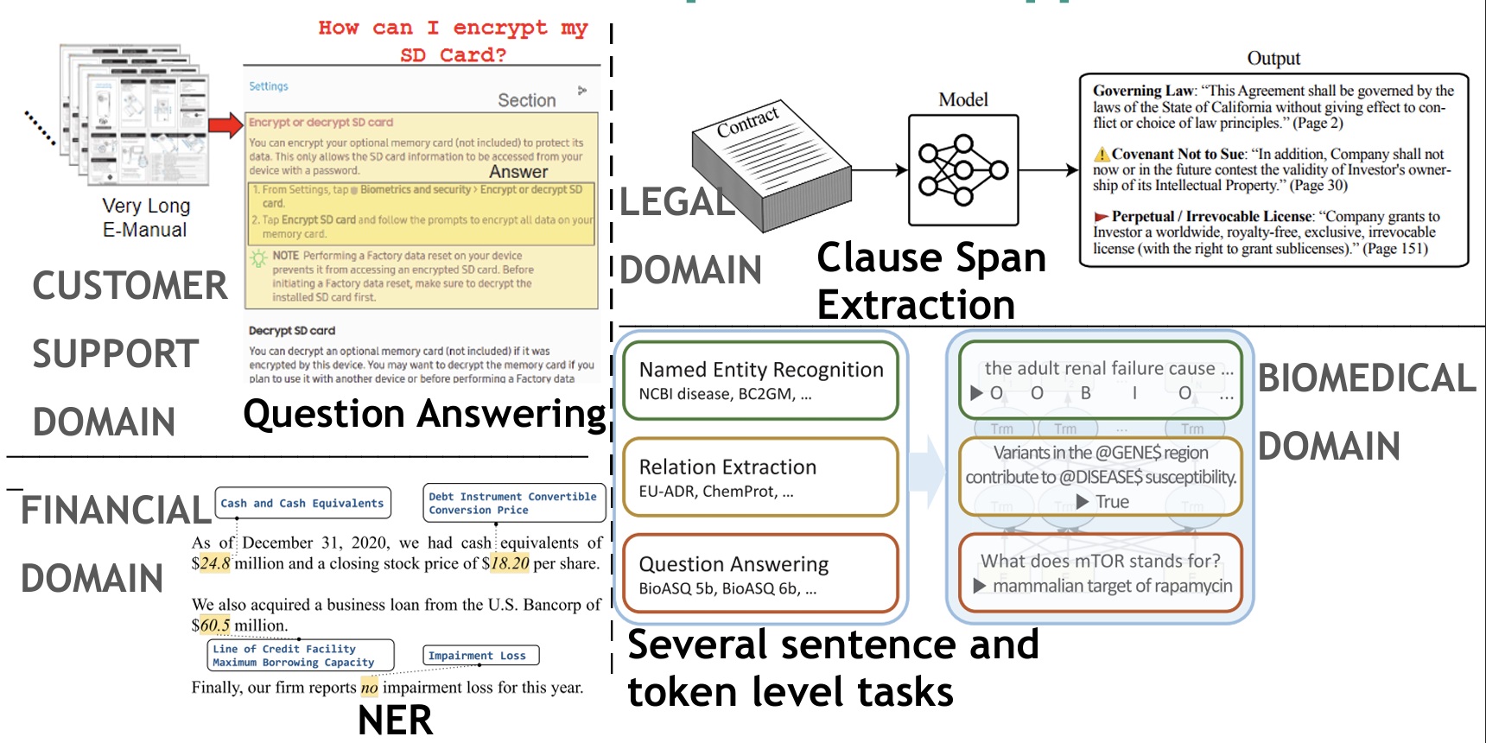
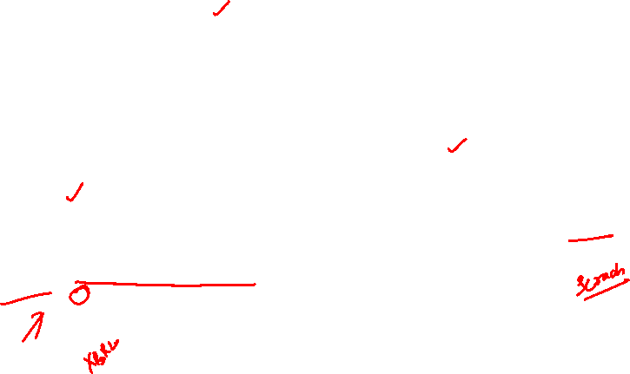
Abundance in domain-specific NLP Applications
Very difficult to get sufficient labeled data for each task

Slide 6

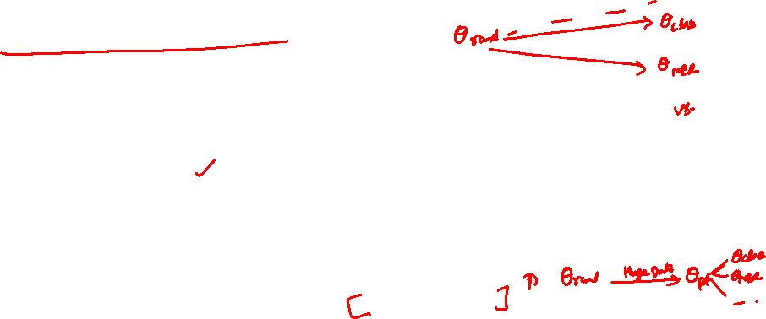
Pretrain-then-Finetune (from 2018)
next word
neural network starting from random weights
+
Stage 1: Pretrain a model
partial input
text
Objective: generate next or masked word (does not require that people label the next word)
neural network starting from pretrained weights
+
Stage 2: Finetune the model
text + labels
Objective: standard supervised training
https://utah-cs6340-nlp.notion.site/
Notes:
These days, NLP models are trained with a so-called pretrain-finetune paradigm.
We first…

Slide 7
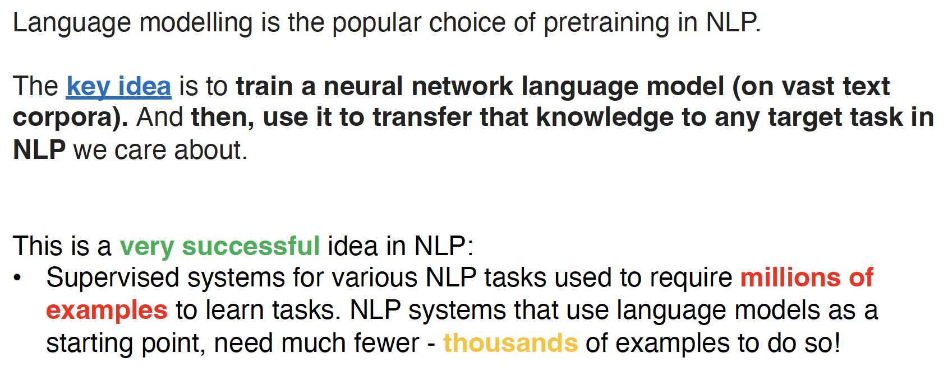

Pretraining with Language Modeling
https://rycolab.io/classes/llm-s24/

Slide 8

What does a model learn from pretraining?
There are canines everywhere! One dog in the front room, and two dogs
It wasn't just big it was enormous
The author of "A Room of One's Own" is Virginia Woolf
The doctor told me that he
The square root of 4 is 2
Text contains enormous amounts of knowledge
Pretraining on lots of text with all that knowledge is what gives language models their ability to do so much
https://web.stanford.edu/~jurafsky/slp3/

Slide 9
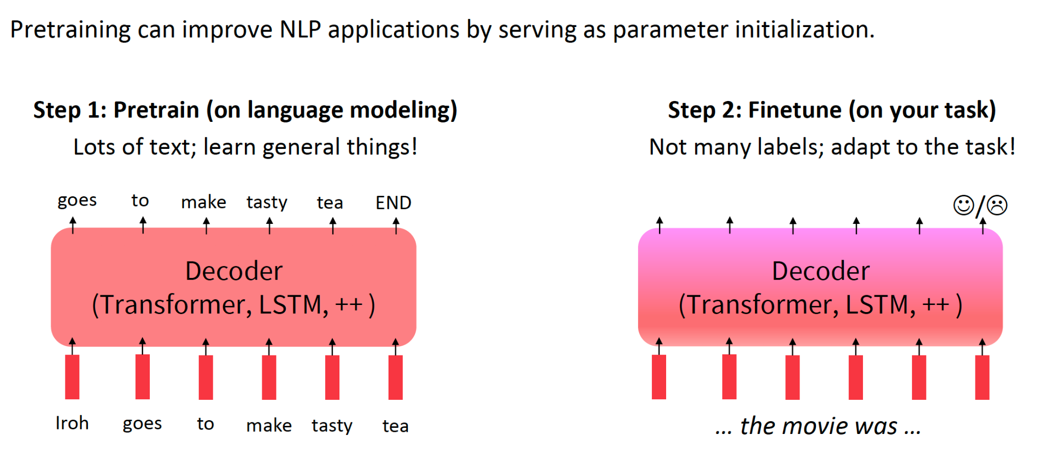
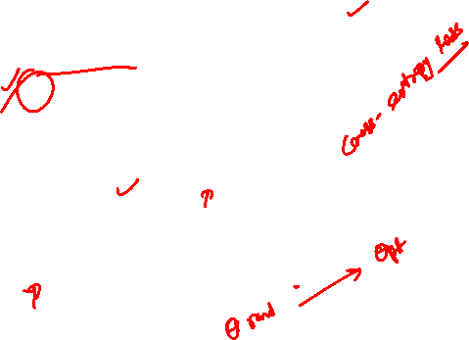
The Pretraining / Fine-tuning paradigm

Slide 10
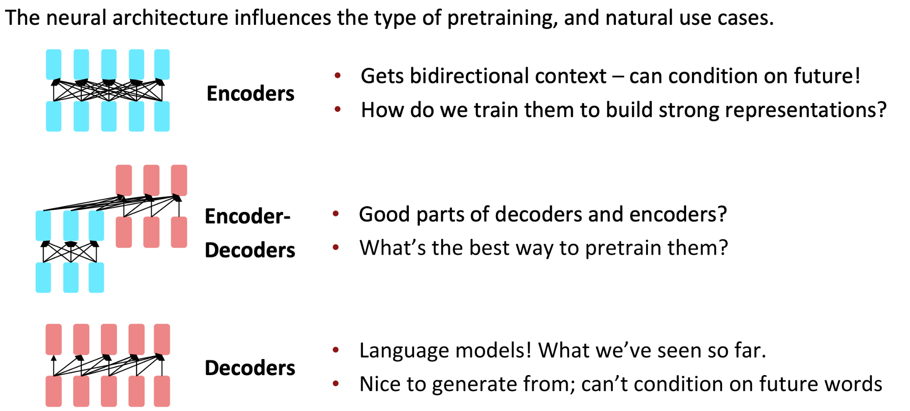

Pretraining for three types of architectures

Slide 11
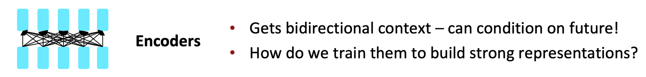
Pretraining Encoders

Slide 12
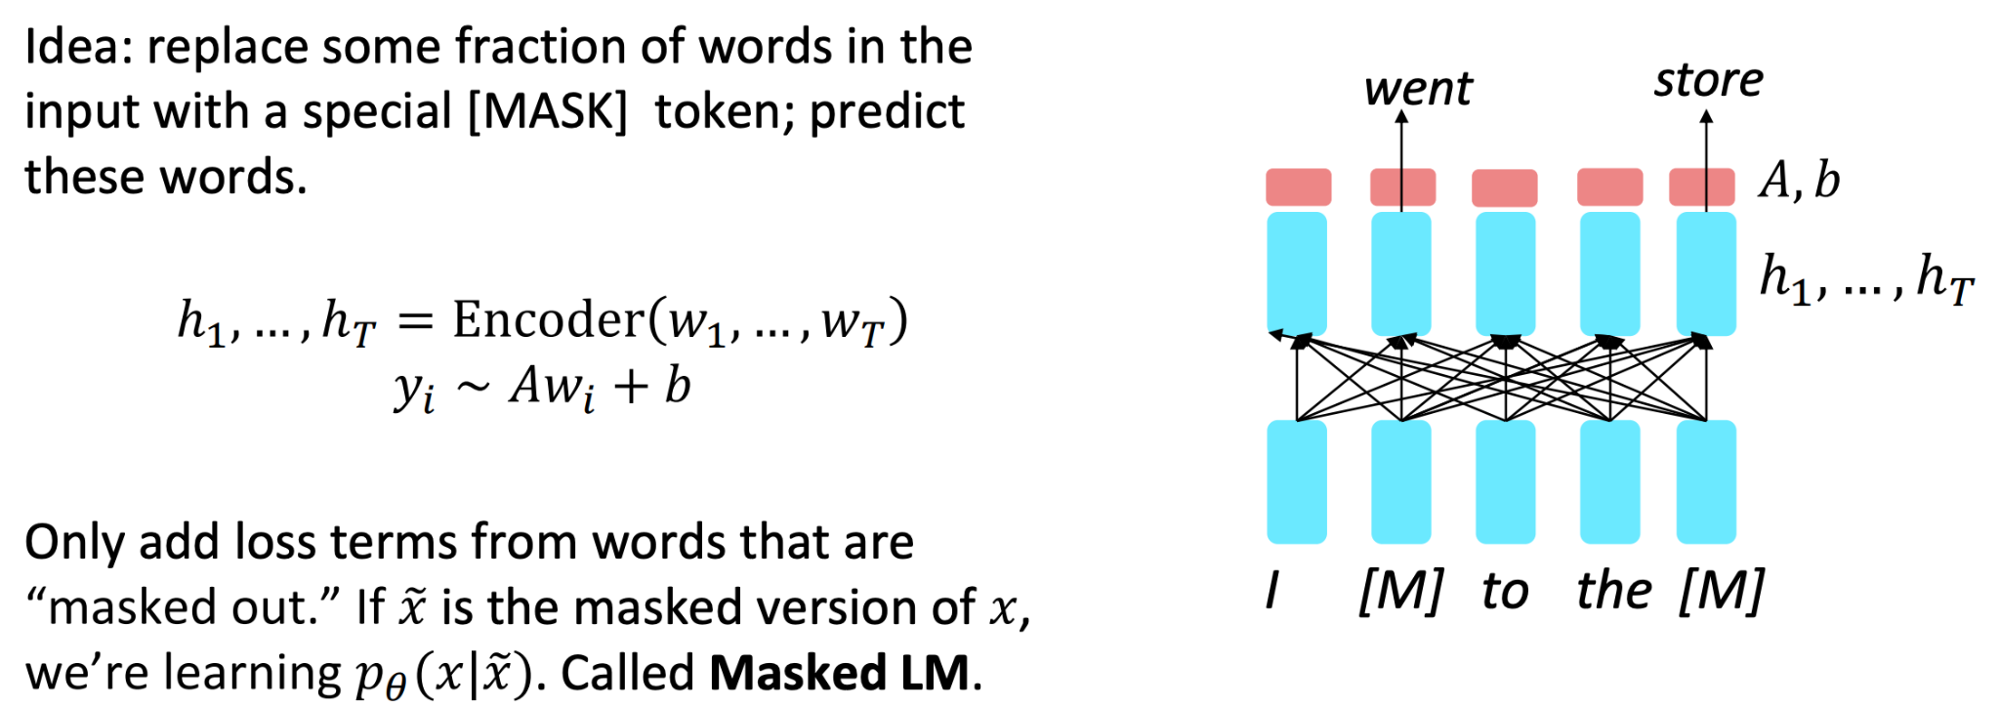
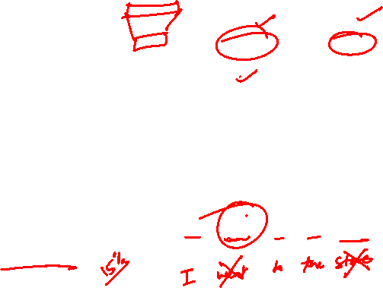
Solution: Use Masks

Slide 13
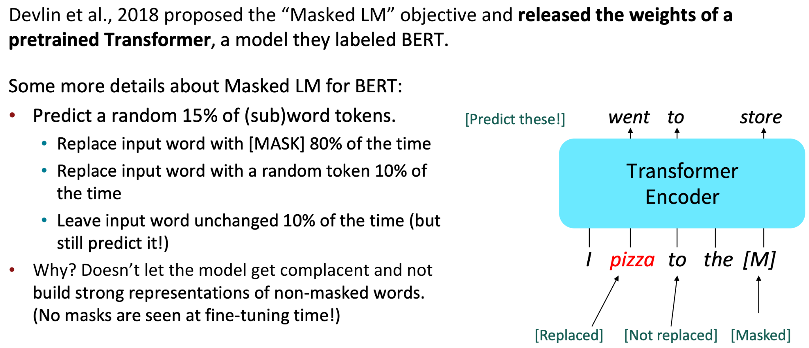
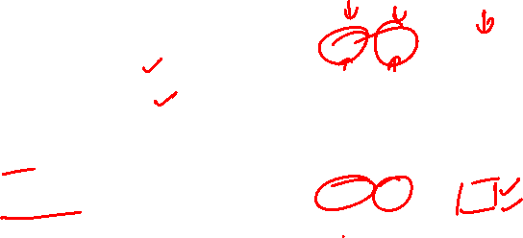
BERT: Bidirectional Encoder Representations from Transformers

Slide 14
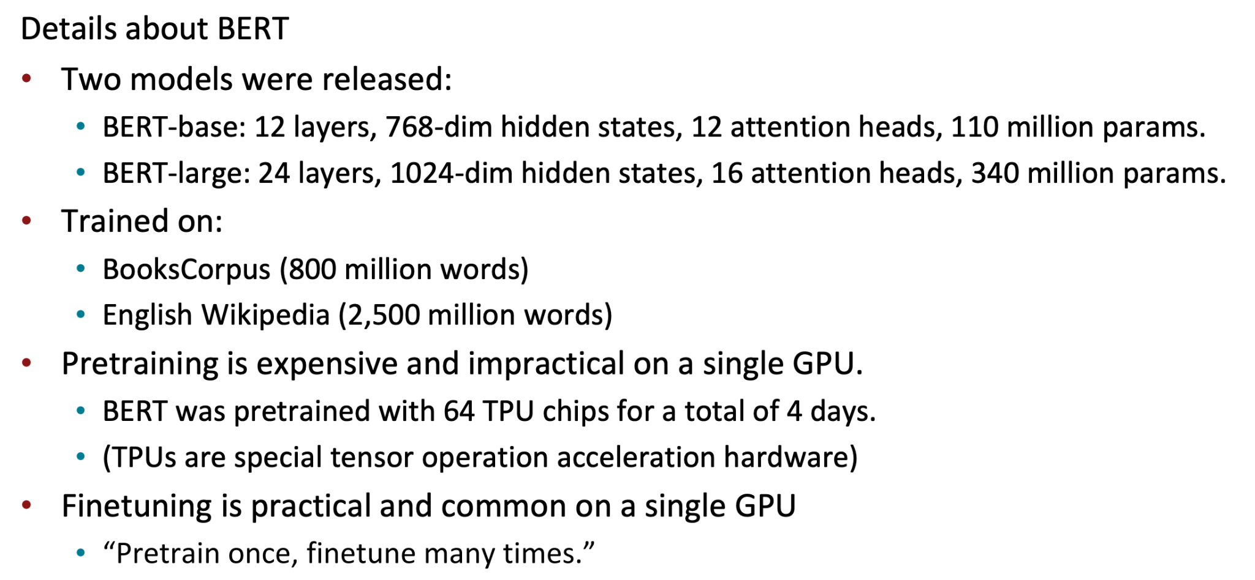
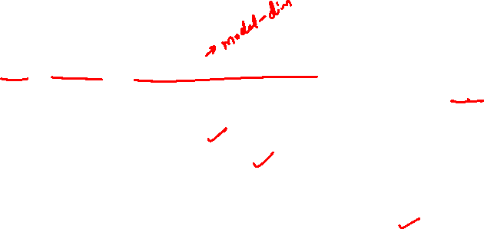
More Details about BERT
BERT vocabulary: 30,522

Slide 15
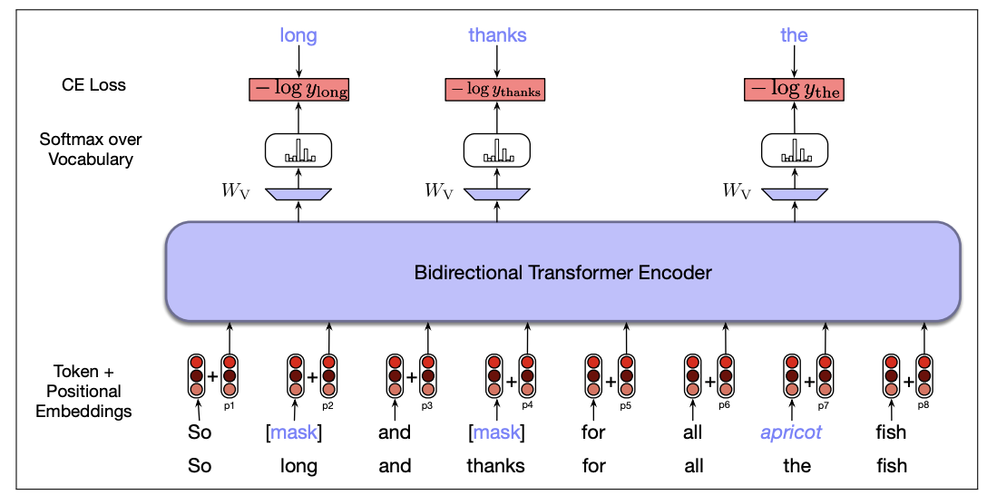
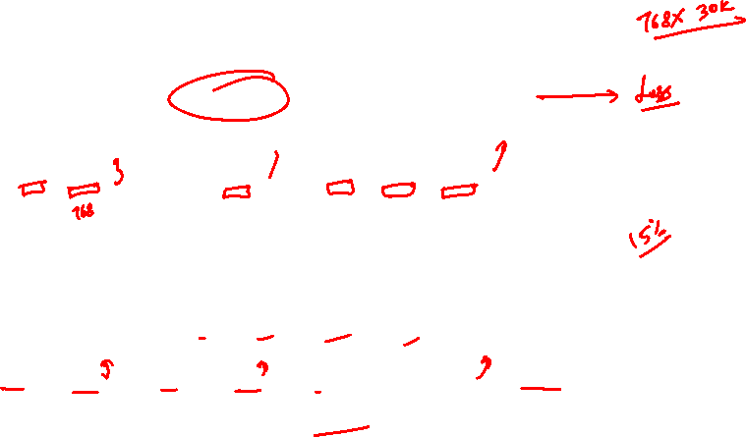
BERT: another view

Slide 16
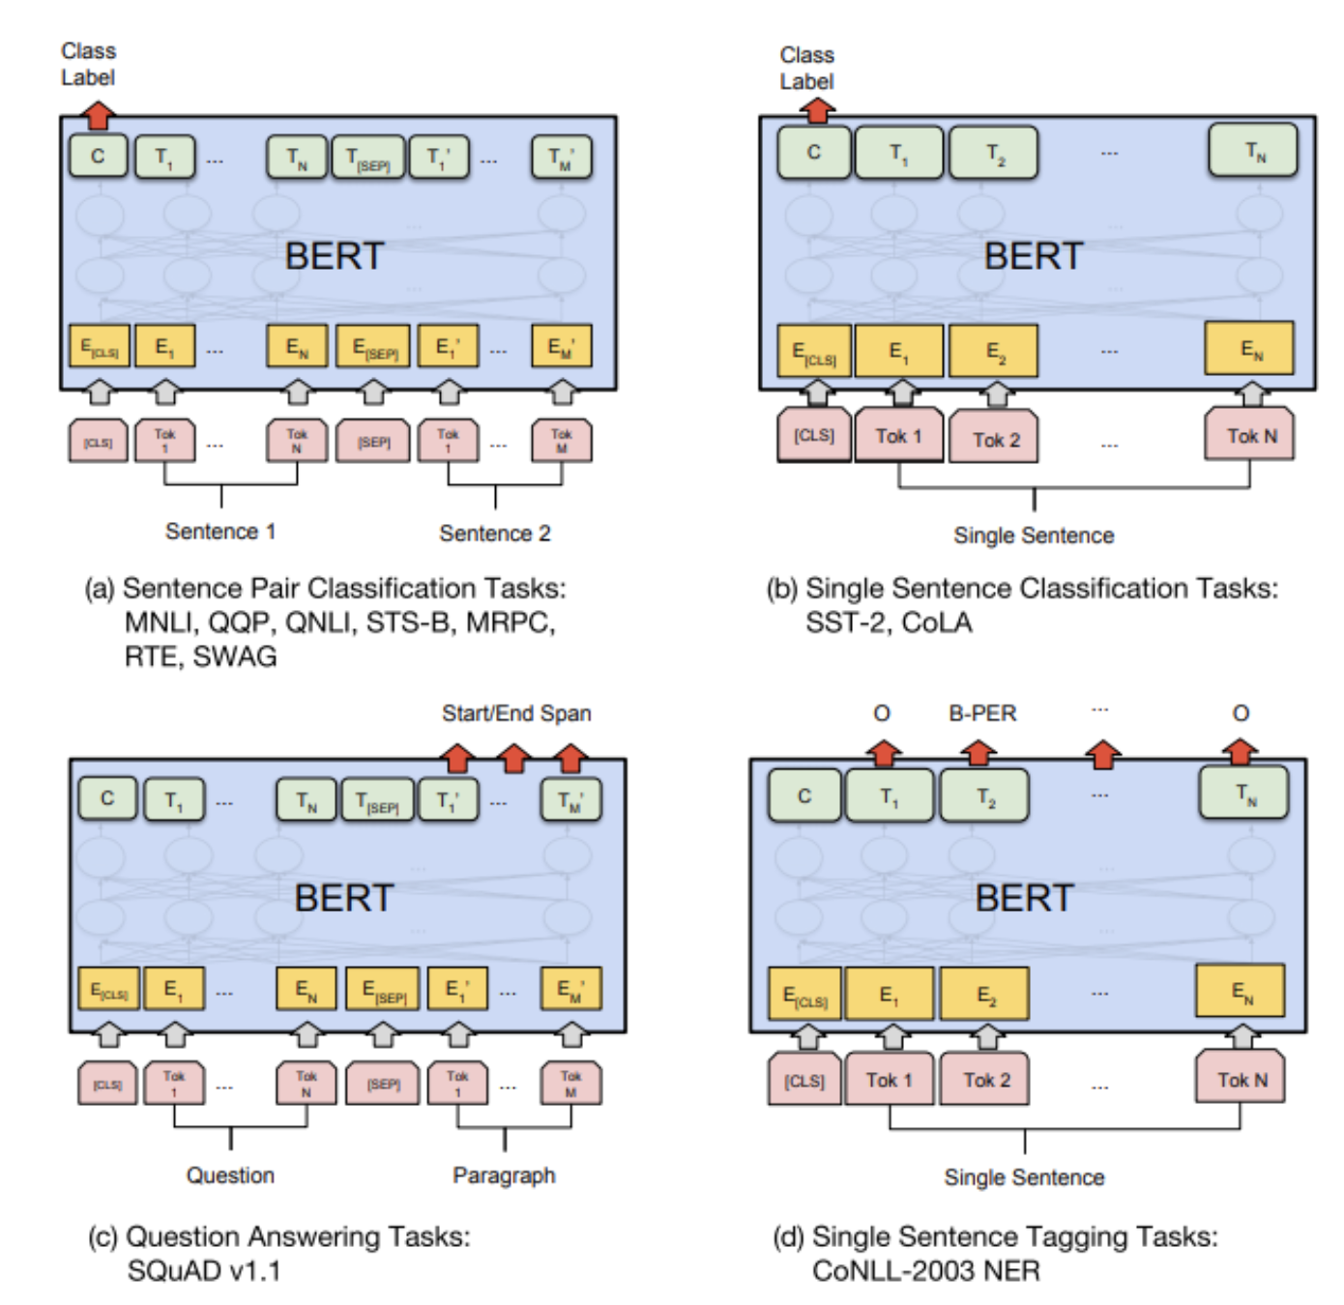
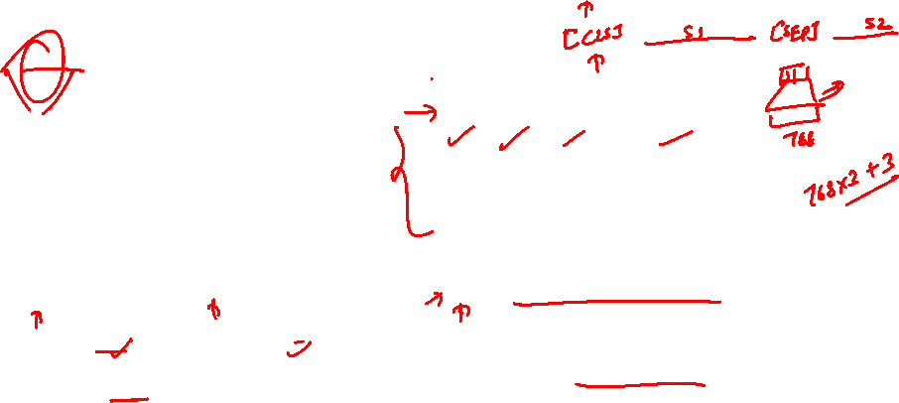
Using BERT for different tasks

Slide 17

Using BERT for different tasks

Slide 18
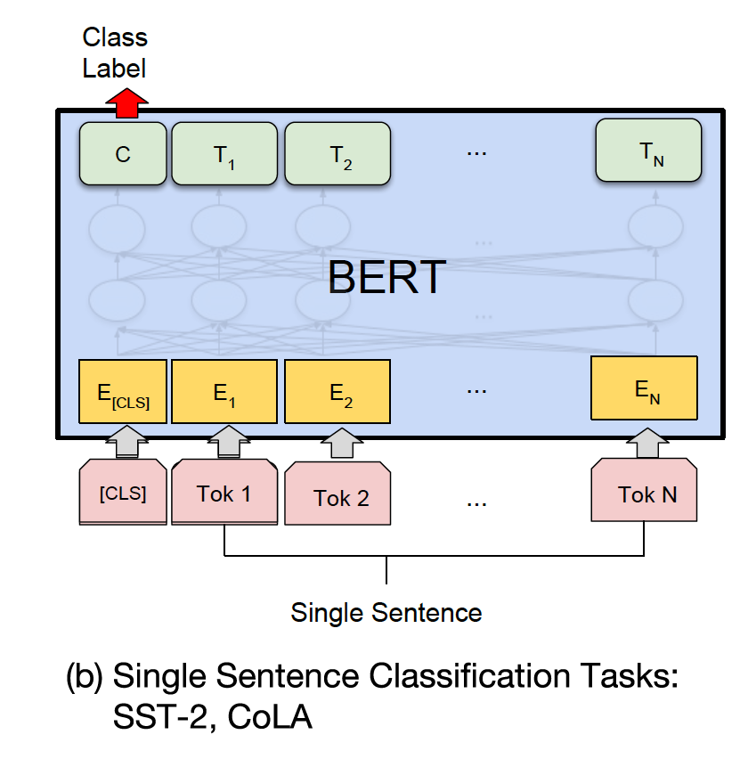
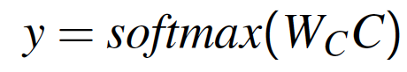
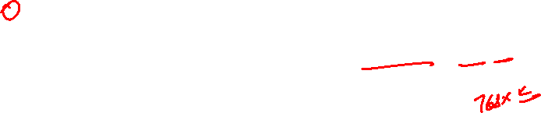
Fine Tuning for Sequence Classification

Slide 19
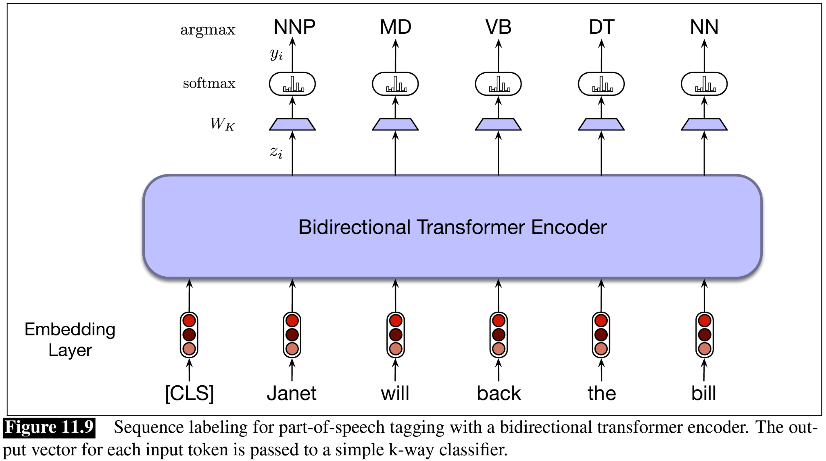

POS Tagging

Slide 20
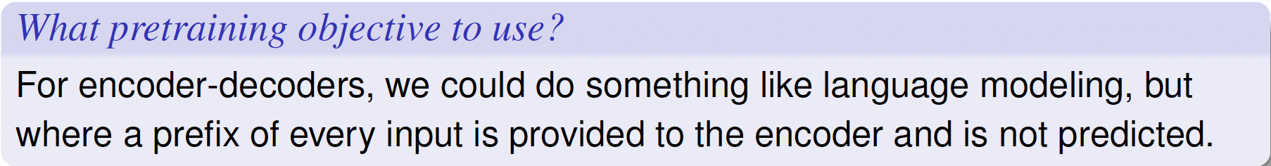
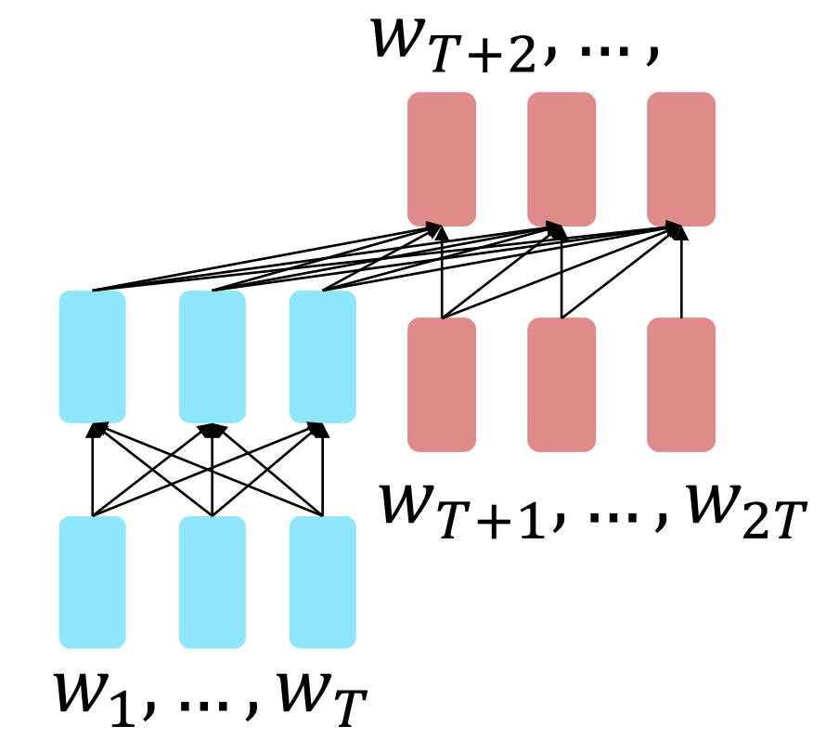
Pretraining encoder-decoders
The encoder portion benefits from bidirectional context; the decoder portion is used to train the whole model through language modeling.

Slide 21
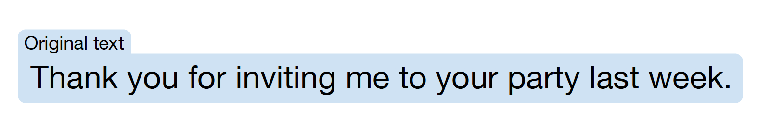
T5: A New Training Objective

Slide 22
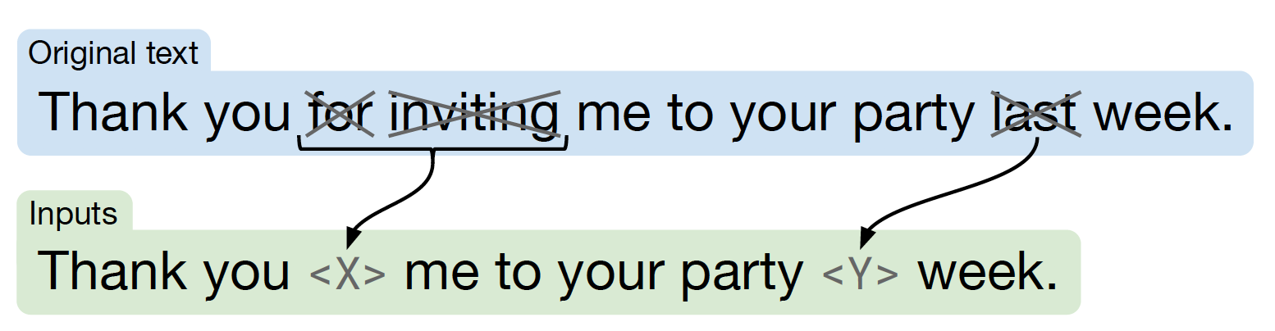

T5: A New Training Objective

Slide 23
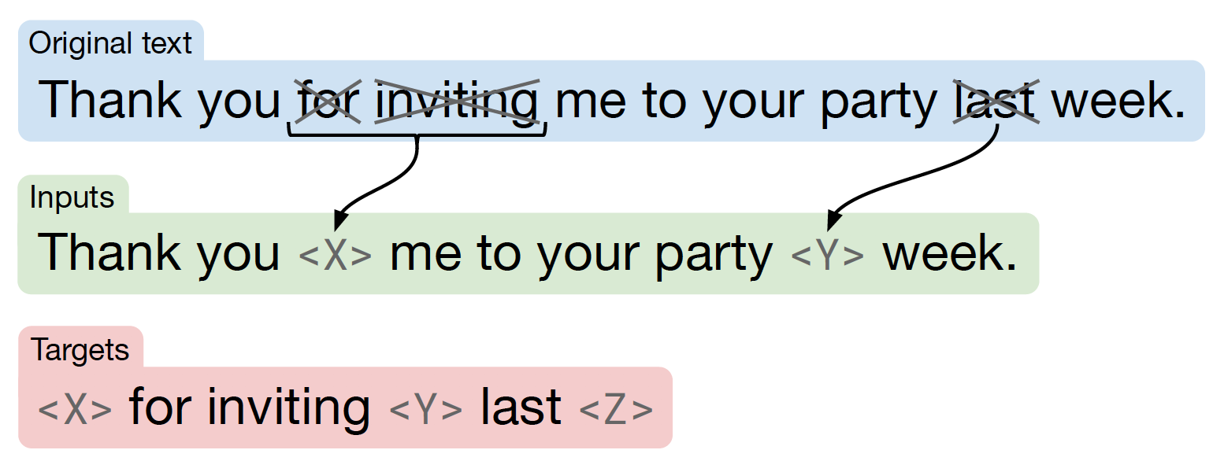

T5: A New Training Objective

Slide 24
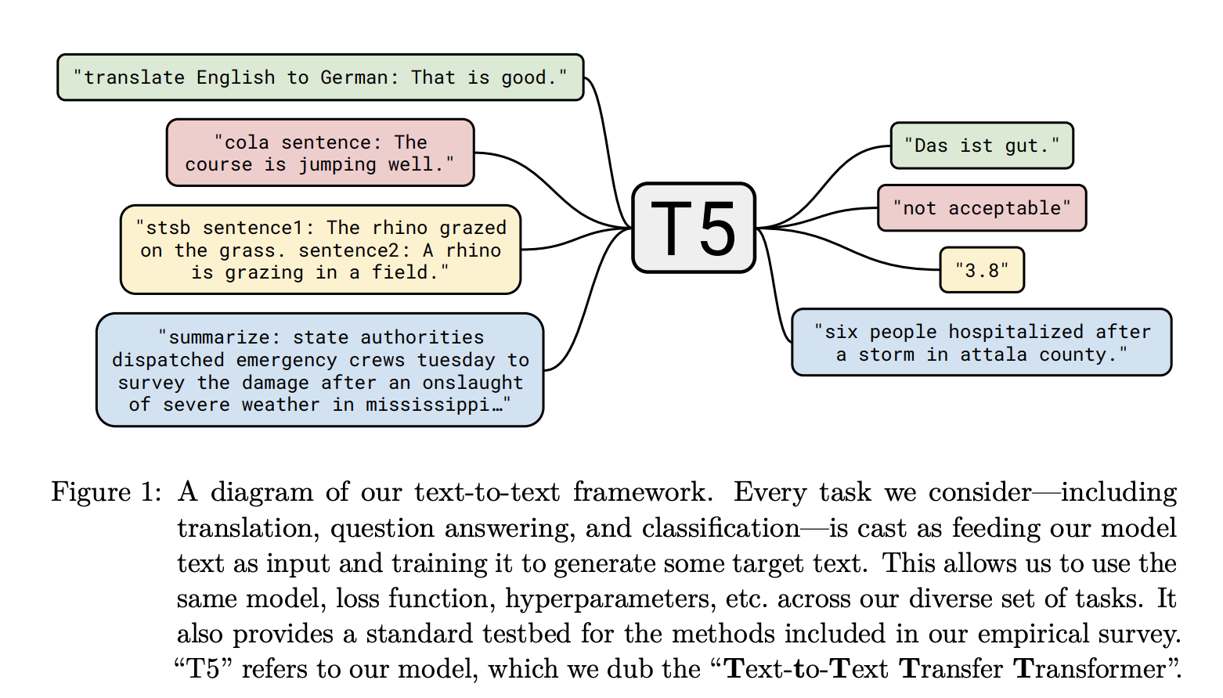

T5 can be used for various tasks

Slide 25
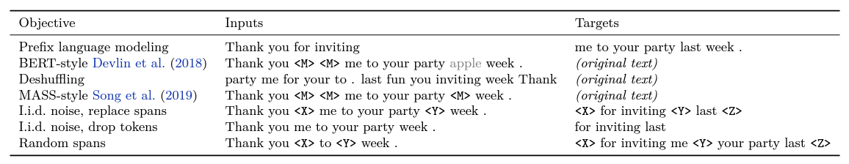
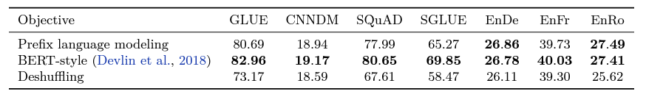
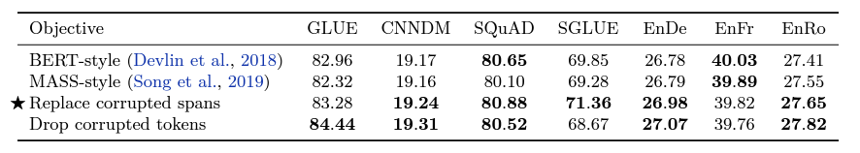

Various objectives considered by T5

Slide 26
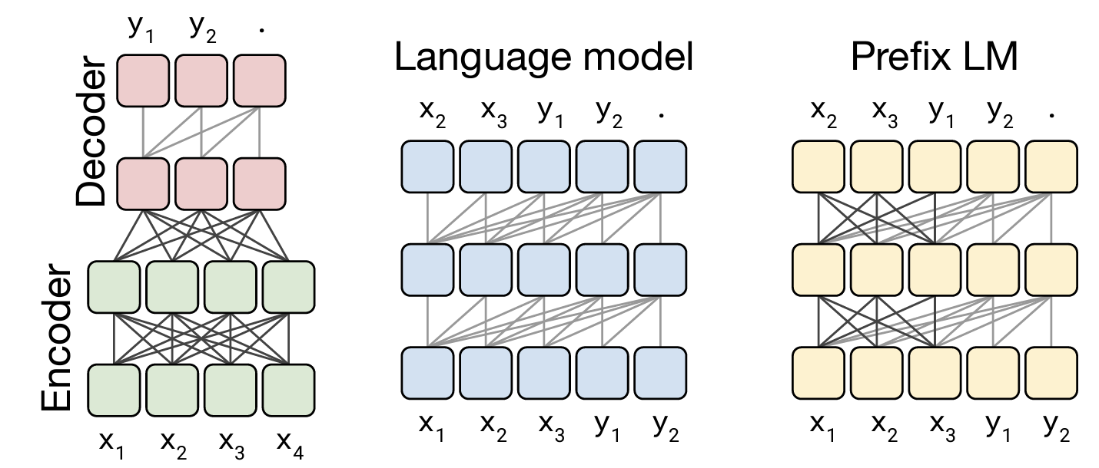

Various architectures considered by T5

Slide 27
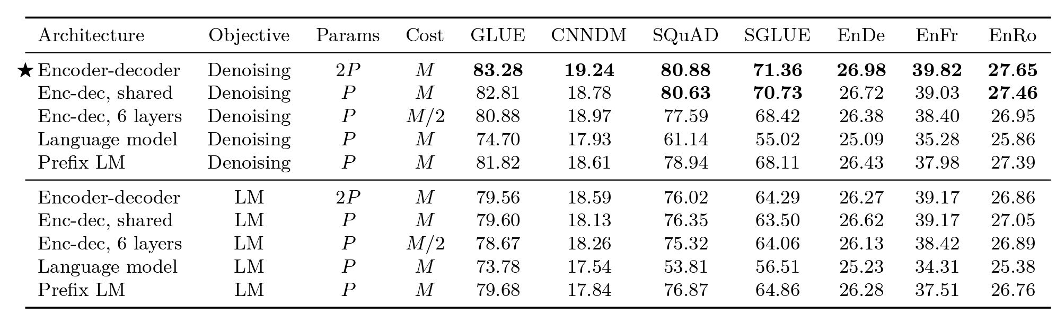
Various architectures considered by T5

Slide 28
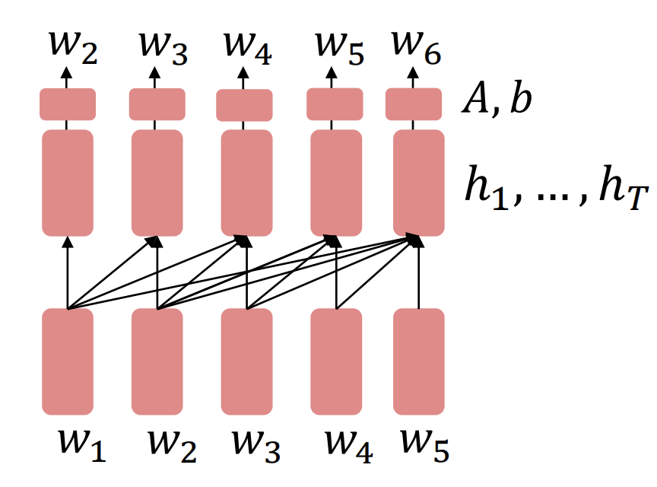

Pretraining Decoders
It’s natural to pretrain decoders as language models

Slide 29
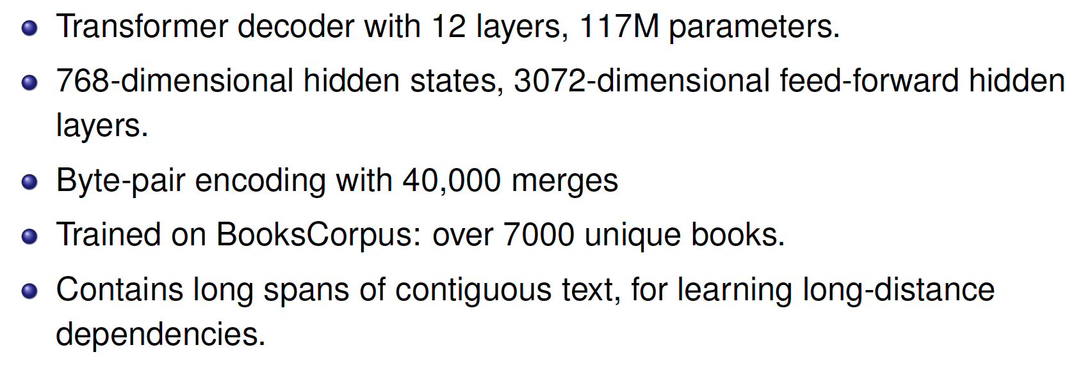

Generative Pretrained Transformer (GPT)
Vocabulary larger than BERT

Slide 30
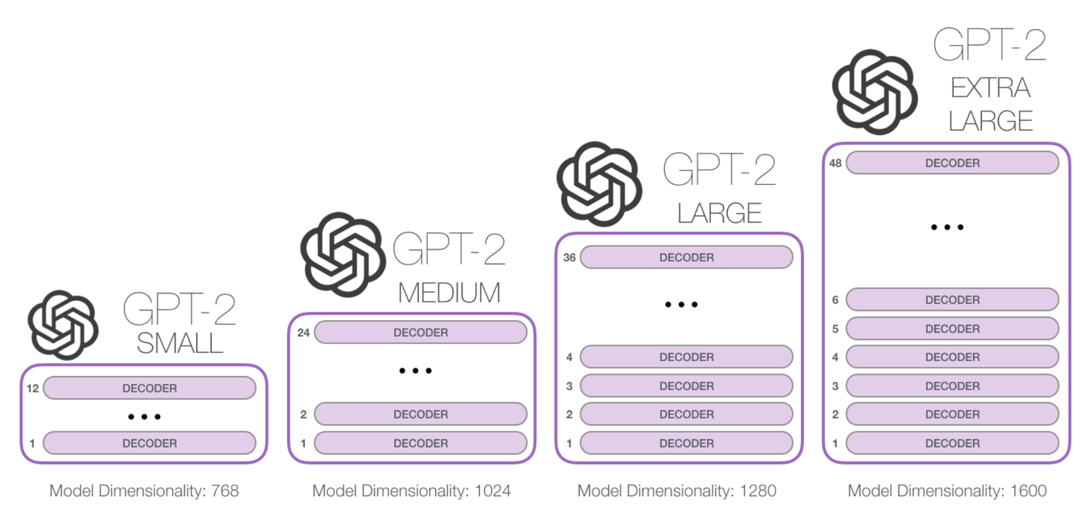

GPT-2
https://jalammar.github.io/illustrated-gpt2/

Slide 31
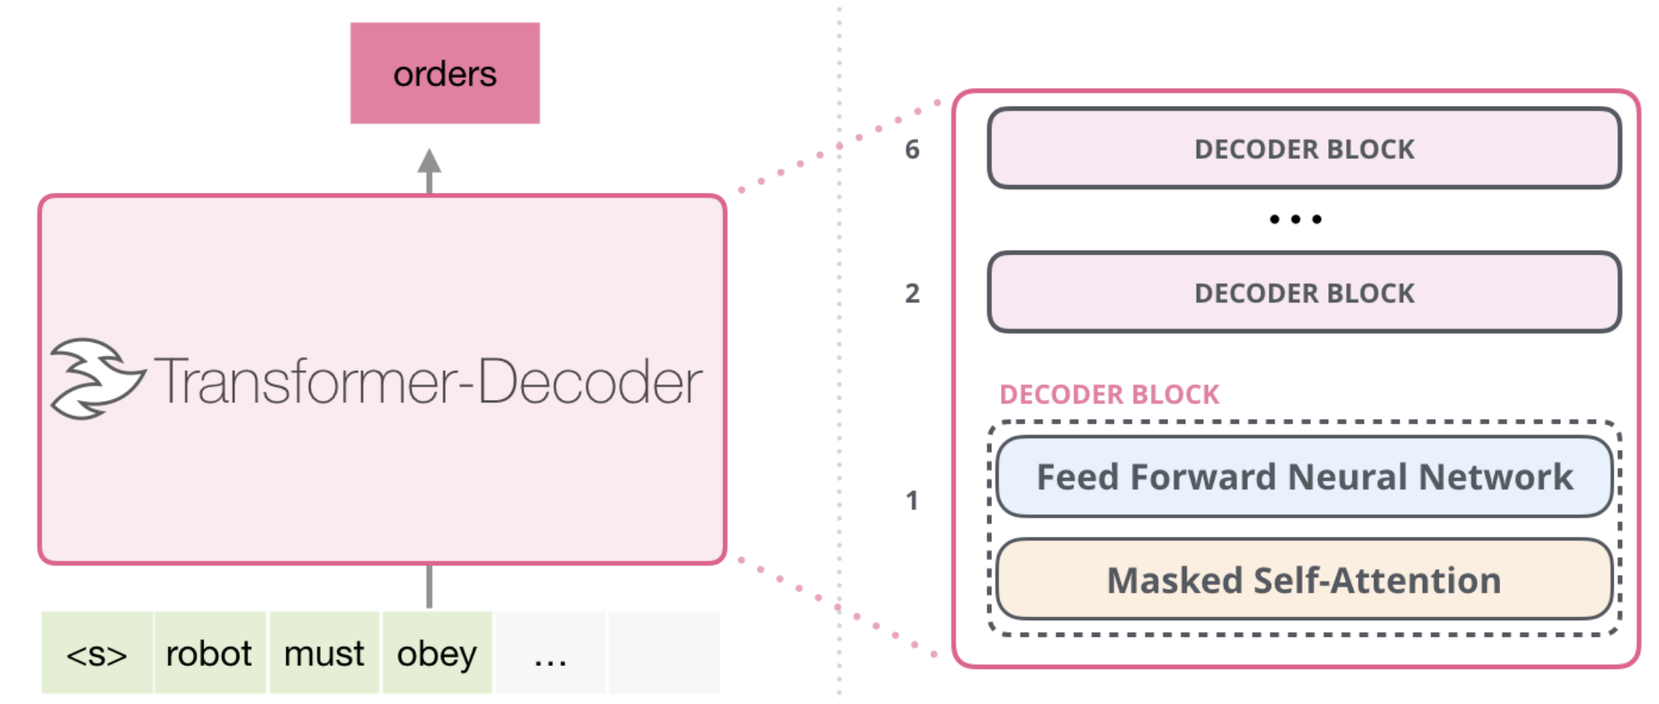

GPT-2: Transformer-Decoder
https://jalammar.github.io/illustrated-gpt2/

Slide 32
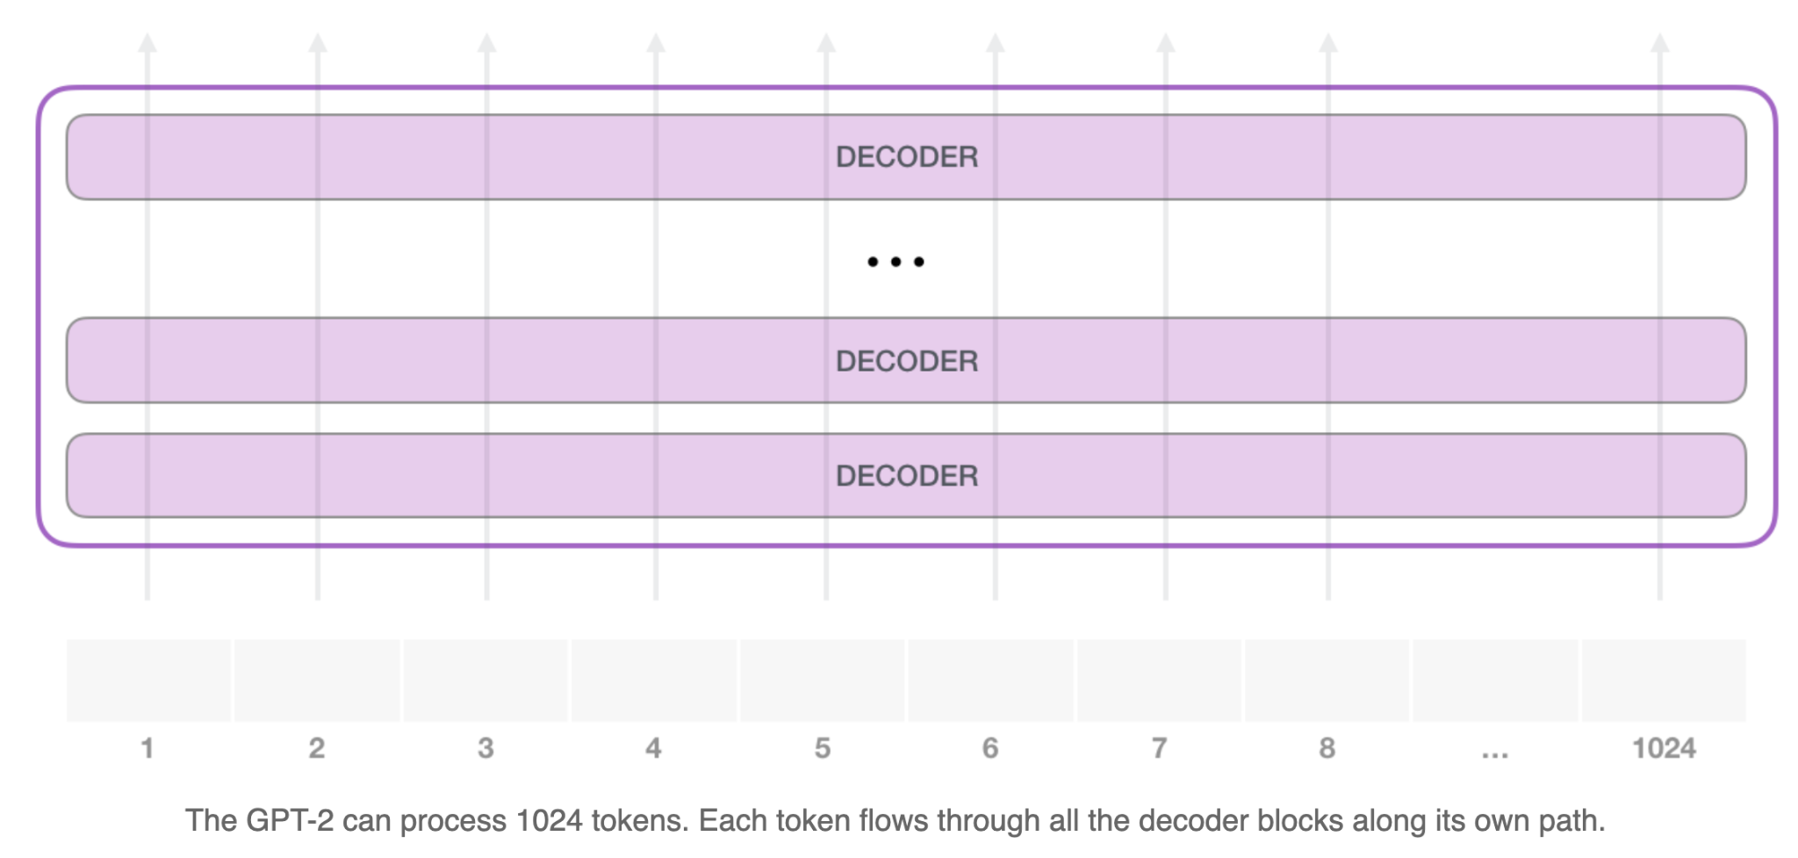
GPT-2: Quick Summary
https://jalammar.github.io/illustrated-gpt2/

Slide 33
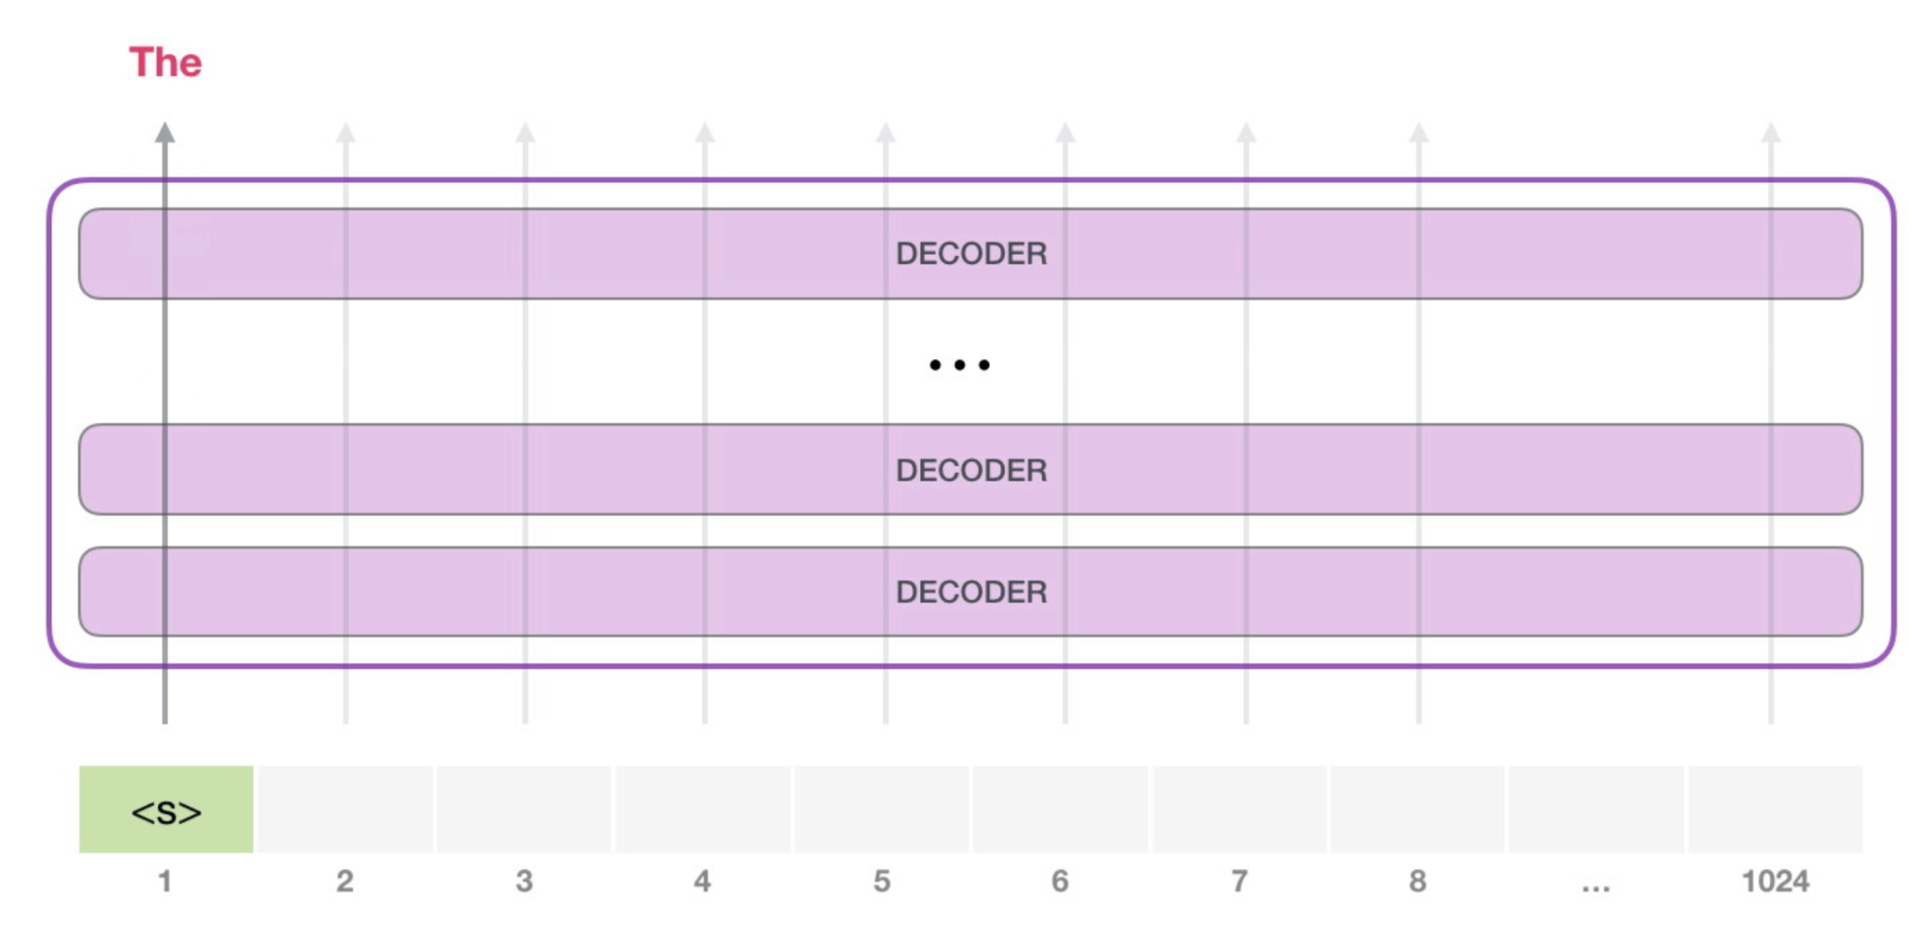

GPT-2: Quick Summary
https://jalammar.github.io/illustrated-gpt2/

Slide 34
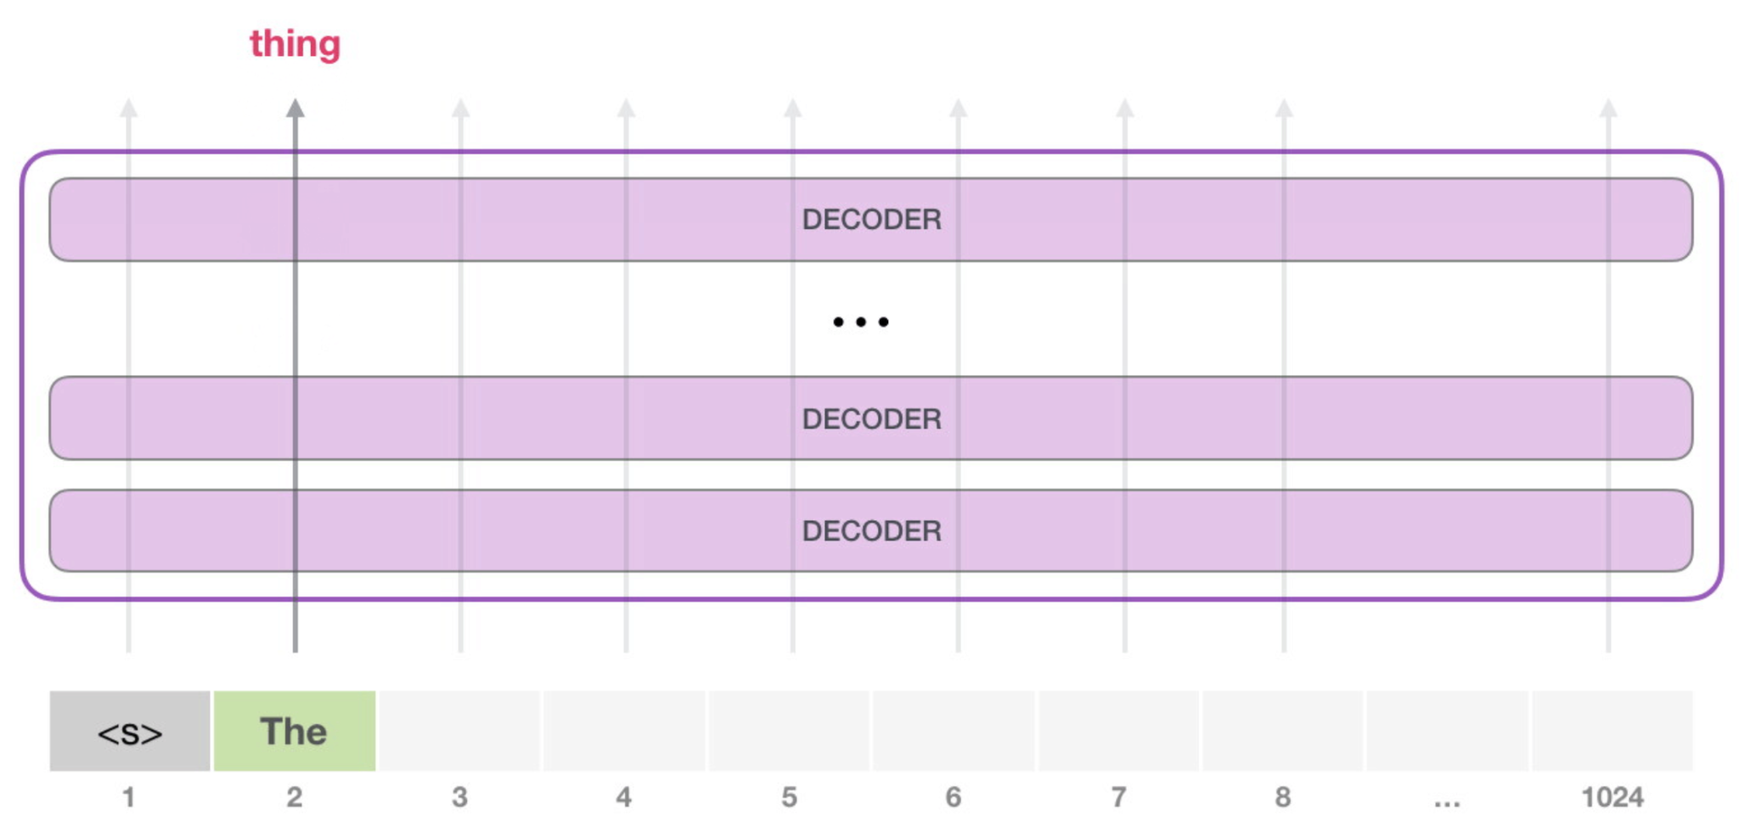
GPT-2: Quick Summary
https://jalammar.github.io/illustrated-gpt2/

Slide 35
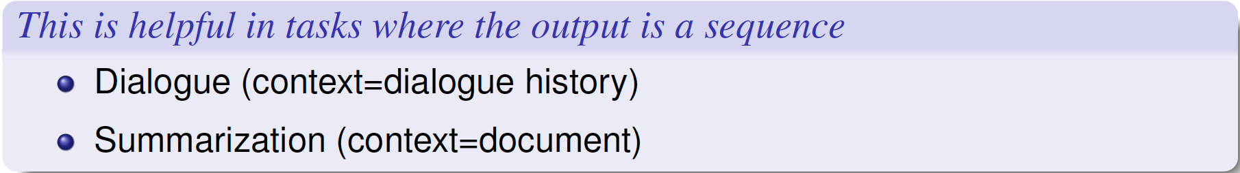
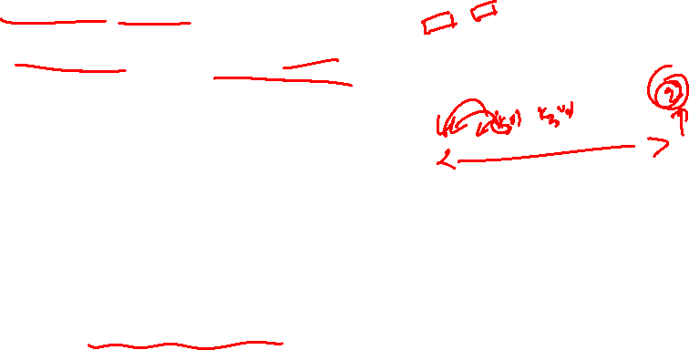
How to use Pretrained Decoders?

Slide 36


GPT-2: Machine Translation
https://jalammar.github.io/illustrated-gpt2/

Slide 37

GPT-2: Summarization
https://jalammar.github.io/illustrated-gpt2/

Slide 38


GPT-2: Zero shot and in-context: Beginning
https://web.stanford.edu/class/cs224u/

Slide 39


GPT-2
Zero-shot task performance of GPT-2 as a function of model size on many NLP tasks
https://rycolab.io/classes/llm-s24/

Slide 40


Cultural Moment: GPT-3
https://web.stanford.edu/class/cs224u/

Slide 41


In-context learning: Terminology
https://web.stanford.edu/class/cs224u/

Slide 42


GPT-3
In in-context learning, we append the task description and a few demonstrations of the task to the original input as the input for the language model, which produces the prediction by auto-regressively predicting next tokens
https://rycolab.io/classes/llm-s24/

Slide 43


Prompting as the standard interface for GPT-3
https://phontron.com/class/anlp2024/assets/slides/anlp-07-prompting.pdf

Slide 44


Recent LLMs: LLaMa2 overview
https://phontron.com/class/anlp2024

Slide 45


Recent LLMs: Falcon Overview

Slide 46


Release date: Very close to each other

Slide 47

What’s new in the architecture?
Multi-query Attention -- instead of usual multi-head self-attention
RMSNorm -- Normalization (instead of LayerNorm)
Handling Long Context
RoPE, ALiBi -- Positional Embeddings (instead of sinusoidal)
SwiGLU -- Gated Linear Unit Variants, different activation (instead of FFN, RelU)

Slide 48

Multi-query attention (and variants)

Slide 49


Multi Query Attention (MQA) and Grouped Query Attention (GQA)
Multi-head attention has H query, key, and value heads. Multi-query attention shares single key and value heads across all query heads. Grouped-query attention instead shares single key and value heads for each group of query heads, interpolating between multi-head and multi-query attention.
https://arxiv.org/pdf/2305.13245

Slide 50

RMSNorm

Slide 51




RMSNorm
Layer normalization formulation is given by
A variant of layer normalization, called root mean square (RMS) layer normalization, only re-scales the input vector but does not recenter it

Slide 52
Handling Long Context

Slide 53


Extending context length: What is the bottleneck?
https://people.cs.umass.edu/~miyyer/cs685/

Slide 54


KV Cache
In training, we can compute attention very efficiently in parallel:
But not at inference! We generate the next tokens one at a time!
For a new token x, need to multiply by W^{Q}, W^{K}, and W^{V} to get query, key, values
But don't want to recompute the key and value vectors for all the prior tokens x_{<i}
Instead, store key and value vectors in memory in the KV cache, and then we can just grab them from the cache
https://web.stanford.edu/~jurafsky/slp3/

Slide 55





KV Cache
https://web.stanford.edu/~jurafsky/slp3/
Notes:
showing, in black, the vectors that can be stored in the cache rather than recomputed when computing the atten- tion score for the 4th token.

Slide 56


Handling Long Context: Variants of attention mechanisms

Slide 57



Sliding window attention and receptive field
Sliding window attention: Attention pattern employs a fixed-size window (w) attention surrounding each token
In a transformer with L layers, the receptive field size at the top layer is L x w

Slide 58
Positional Embeddings - ALiBi

Slide 59



Attention with (non) learnable biases
This embedding model treats each token independently and therefore ignores the distance between different tokens.
We can use self-attention with relative positional embedding
Intuitively, PE(i, j) can be interpreted as a distance penalty for the pair of positions i and j. As i moves away from j, the value of PE(i, j) decreases.
Foundations of Large Language Models

Slide 60



Attention with non-learnable biases
In the Attention with Linear Biases (ALiBi) approach, the bias term is defined as the negative scaled query-key offset
can be interpreted as adding a fixed penalty whenever j moves one step away from i.
Foundations of Large Language Models

Slide 61



Attention with linear biases (ALiBi)
Foundations of Large Language Models

Slide 62
Positional Embeddings - RoPE

Slide 63



Rotatory Positional Embeddings
Sinusoidal positional embeddings are based on hard-coded values for all dimensions of an embedding (additive)
Rotary positional embeddings instead model positional context as rotations to token embeddings in a complex space. This leads to a model expressed in the form of multiplicative embeddings
Consider a 2-dimensional token embedding
Rotation matrix
Foundations of Large Language Models

Slide 64




Rotatory Positional Embeddings
Let v = (x, y)
If x and y are the coordinates of the endpoint of a vector with the length r and the angle ϕ with respect to the x-axis

Slide 65


Rotatory Positional Embeddings
More formally, rotating a vector by an angle θ for t times can be expressed as
Interpret t as the position of a token represented by x in a sequence.
We start moving the token from position 0.
Each time we move one step forward, the vector is rotated by the angle θ.
Upon arriving at the position t, the representation of the token with positional context is given by Ro(x, tθ).
Rotations do not change the magnitude of the embedding, the positional information is injected into the embedding, when it gets rotated.
Foundations of Large Language Models

Slide 66


Making sense of Rotatory positional embeddings
Foundations of Large Language Models

Slide 67


Making sense of Rotatory positional embeddings
Given that the distance between cat and sleeping is the same in both sentences, the angle between their embeddings also remains the same during rotation.
Foundations of Large Language Models

Slide 68



Extending to d-dimensional embeddings
Foundations of Large Language Models

Slide 69


Rotatory embeddings and self-attention
query and key representation for the m^{th} position with RoPE
Note: d is the dimension of the query/key. d = d_{model} / n_{head} = 4096/32 = 128 (setting of LLaMA 7B).
https://arxiv.org/pdf/2104.09864

Slide 70


Visualization of RoPE
https://arxiv.org/pdf/2104.09864

Slide 71

SwiGLU

Slide 72



Gated Linear Units (GLU) and variants
Gated Linear Units consist of the component-wise product of two linear projections, one of which is first passed through a sigmoid function
They also suggest omitting the activation, which they call a "bilinear" layer
With other activation functions
https://arxiv.org/pdf/2002.05202

Slide 73


Activation Functions: Gaussian Error Linear Unit (GELU)
https://web.eecs.umich.edu/~justincj/slides/eecs498/FA2020/

Slide 74



Activation Functions: Swish
β is either a constant or a trainable parameter
β = 1.702, behaves like GELU
β→∞, behaves like ReLU
https://arxiv.org/pdf/1710.05941

Slide 75

Summary
Pretrained transformers : Encoder, Decoder, Encoder-Decoder
Various Architectural Variations : Transformers is the base architecture, but various modifications in the way these are used in the recent models

Slide 76

Thank You!!

Slide 78


Slide 79


Slide 80


Slide 81


Slide 82


Slide 83


Slide 84


